Slide 1
Automatic stamping machine
Group member:
Sudarshan Dhage
Rohit patil
Shivani
Mohini wable
Rohit sonawane

Slide 2
Introduction
Automatic stamping machines have become increasingly popular in recent years due to their ability to efficiently and accurately stamp a wide range of materials. These machines are particularly useful for businesses that require large-scale stamping operations, as they can significantly reduce the time and labor required for this task.One of the key components of an automatic stamping machine is the use of an Arduino microcontroller, which allows for precise control over the stamping process. Additionally, relays and solenoids are used to activate the stamping mechanism, ensuring that each stamp is consistent and accurate.

Slide 3
Objective
The objective of an automatic stamping machine is to automate the process of stamping a specific design or information onto a surface, such as paper, plastic, or metal. This is typically done for identification or branding purposes. By automating the stamping process, the machine can increase efficiency and consistency, reduce errors, and save time and labor costs compared to manual stamping. The specific objectives of an automatic stamping machine may vary depending on the needs of the user, but generally, the goal is to streamline the stamping process while maintaining accuracy and quality.

Slide 4
problem statement
The problem statement of an automatic stamping machine may vary depending on the specific application and industry it is designed for. However, some common problems that an automatic stamping machine may aim to address include:
Inefficiency and inconsistency in the manual stamping process: Manual stamping can be time-consuming, labor-intensive, and prone to errors or inconsistencies in the stamped design or information. An automatic stamping machine can solve this problem by automating the stamping process, reducing the need for manual labor, and ensuring consistent and accurate stamping every time.
Limited customization options: Manual stamping may be limited in terms of the design or information that can be stamped onto a surface. An automatic stamping machine can address this problem by allowing for more flexibility and customization options, such as the ability to program multiple designs or information to be stamped onto different surfaces.
High labor costs: Manual stamping requires significant labor, which can be expensive for businesses in the long run. An automatic stamping machine can reduce labor costs by automating the stamping process and requiring minimal human intervention.
Limited speed: Manual stamping can be a slow process, which can result in backlogs and delays. An automatic stamping machine can solve this problem by stamping at a much faster rate than manual labor, increasing productivity and reducing turnaround times.
Overall, the problem statement for an automatic stamping machine is to optimize the stamping process, increase efficiency, reduce errors, and lower costs while maintaining quality and accuracy.

Slide 5
components
Double acting cylinder
DC single acting 5/2 solenoid valve
Silencer
Arduino UNO
Relay
Pipe
Adapter

Slide 6
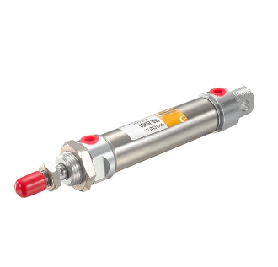
Double Acting Cylinder
In the context of automatic stamping on soap, a double-acting pneumatic cylinder can be used to control the movement of the stamping tool. This mechanism enables the stamping tool to move in both directions with the help of compressed air, without the need for any external power source.
In an automatic stamping machine, the stamping tool needs to be controlled precisely to ensure accurate and consistent stamping on each soap bar. The double-acting pneumatic cylinder mechanism enables this control by providing a consistent and reliable force to the stamping tool in both the up and down directions.

Slide 7
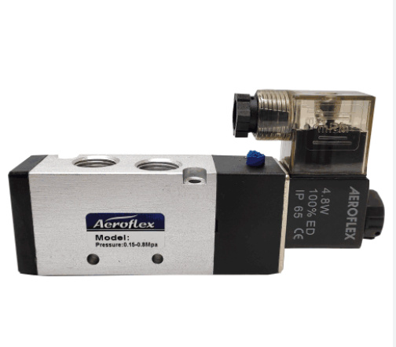
DC Single Acting 5/3 Solenoid Valve
In the context of automatic stamping on soap, a DC single acting 5/3 solenoid valve can be used to control the movement of the stamping tool. This valve enables the stamping tool to move in one direction with the help of a DC voltage and a compressed air source.
In an automatic stamping machine, the stamping tool needs to be controlled precisely to ensure accurate and consistent stamping on each soap bar. The DC single acting 5/3 solenoid valve mechanism enables this control by providing a consistent and reliable force to the stamping tool in one direction.

Slide 8
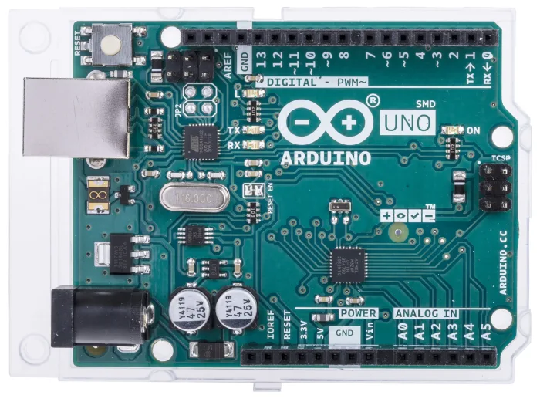
Arduino UNO
In an automatic stamping machine, the Arduino Uno can also be connected to a relay module to control the power supply of other components, such as the motor or the ink pad. A relay is an electrically operated switch that can be controlled by a small current, and it can switch a larger current on or off.The relay module can be connected to the Arduino Uno using the digital input/output pins. The Arduino can then send signals to the relay to control the power supply of the connected component. For example, the Arduino can turn on the relay to power the motor and move the stamp up and down, and turn off the relay when the stamp is in the correct position.Using a relay with the Arduino Uno can provide additional safety and protection, as it can isolate the high-voltage power supply of the motor or ink pad from the low-voltage control circuitry of the Arduino.

Slide 9
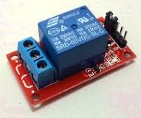
Relay
A 5 volt relay can be used in an automatic stamping machine to control the power supply of components such as the motor or ink pad. It is a type of relay that is designed to operate on a 5 volt power supply, which is commonly used in Arduino-based projects.The 5 volt relay works by using a low current signal, such as that provided by an Arduino Uno, to control a high current circuit. The relay consists of a coil, a set of contacts, and a spring. When a current is applied to the coil, it creates a magnetic field that pulls the contacts together, closing the circuit and allowing current to flow through the high voltage or high current circuit.To use a 5 volt relay in an automatic stamping machine, the relay can be connected to the Arduino Uno using digital input/output pins.

Slide 10
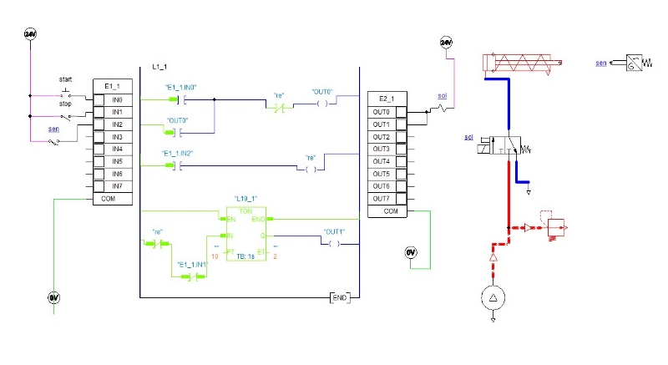
Circuit Diagram

Slide 11
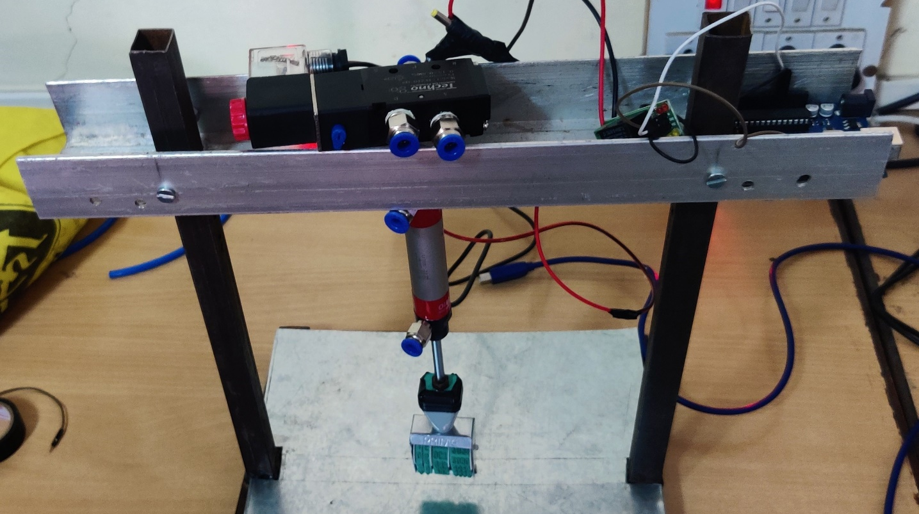
Working Model Of Automatic Stamping Machine

Slide 12
Advantages
Fast and efficient operation
Consistency and precision
Customization
Durability
Low maintenance
Safety

Slide 13
Disadvantages
There are several potential disadvantages of using the specific components listed for the automatic stamping machine on soap.
Firstly, the cost of the components may be high, particularly if high-quality parts are used, which could make the overall cost of the machine relatively expensive.
Secondly, there may be maintenance issues associated with the use of pneumatic cylinders, solenoids, and other mechanical components. These components may require periodic lubrication, cleaning, or replacement, which could add to the overall maintenance cost of the machine.
Thirdly, the use of a DC to DC step-up device could introduce additional complexity into the system and increase the risk of failure or malfunction. If the device is not properly designed or installed, it could potentially damage other components or cause the system to malfunction.

Slide 14
Application
Production of branded soaps: Soap manufacturers can use the automatic stamping machine to produce branded soaps with customized designs and logos, which can help increase brand recognition and customer loyalty.
Personalized gift soaps: The machine can also be used to create personalized gift soaps for special occasions, such as weddings, birthdays, and holidays, with unique designs and messages.
Production of limited edition soaps: The machine can also be used to create limited edition soaps with unique designs, which can help drive sales and create a sense of exclusivity among customers.
Soap packaging and labeling: The machine can be used to stamp the soap packaging or labeling with product information, such as ingredients, weight, and manufacturing date.

Slide 15
Conclusion
In conclusion, the automatic stamping on soap using double acting pneumatic cylinder, DC single acting 5/2 solenoid, DC to DC step-up device, silencer, Arduino nano, and 6mm pipe is a highly efficient and effective system for soap stamping. This system utilizes various components to create a fully automated stamping process that reduces the need for manual labor and increases the speed of production. The system is also highly customizable, allowing for various stamp designs and sizes to be easily incorporated into the process. Additionally, the use of pneumatic components and the silencer greatly reduces the noise level and ensures a smooth and precise stamping process. While there may be some drawbacks to this system, such as the need for regular maintenance and the potential for component failure, the advantages and benefits of this system outweigh any potential downsides. Overall, the automatic stamping on soap using these components is a reliable and efficient solution for soap manufacturers seeking to streamline their production process.

Slide 16
Thank You..

